Slide 1

ESG Masterclass for Local Consultants
ESG: Why it’s critical for SMEs & how to help them get started
20th of December 2022

Slide 2
Introductions, Training Outline & Objectives
Hour | Part / Subject | Duration
10:00-10:05 | Introductions, training outlines and objectives | 5 min
10:05-10:40 | Part A - What is ESG About ESG overview and definition ESG and the bottom line The ESG Ecosystem IFI standards | 40 min
10:40-11:20 | Part B - How can SMEs integrate ESG into governance, strategies, policies, risk management, and reporting ESG Governance ESG Strategy and Policy ESG Risks & Opportunities ESG Training & Capacity Building ESG Digitilisation | 40 min
11:20-11:40 | Part C – Opportunities and Processes for SMEs financing Sustainable Finance E&S Due Diligence and Monitoring | 20 min
11:40-12:00 | Q&A – Wrap up – Evaluation | 15 min

Slide 3
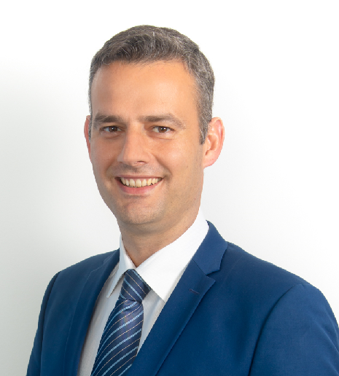
About the Trainer
  Michael Spanos, Founder and CEO, Global Sustain Group
  Trainer & Adviser for EBRD Financial Intermediaries and SME clients in several regions of operation on ESG Risk Management and Sustainable Finance
  Trainer & Adviser for Moody’s ESG & Sustainable Finance clients
  Over 17 years of working experience in ESG/Sustainability
  MBA (Financial Engineering), Diploma in Production Engineering & Management
  Visiting Lecturer in Universities in USA, Europe and the Middle East
  Certificated Green and Sustainable Finance Professional and Professional Banker by the Chartered Banker Institute
  Held positions in risk management, investments, venture capital, financial modelling, credit rating agency, banking regulation and management consulting
  Currently, consult with senior management to enhance skills and capacity building in ESG, sustainable finance, banking and investments
  Assist in improving ESG/sustainability acumen for key roles in banks, private equity funds, asset managers, corporations and SMEs.
  michael.spanos@globalsustain.org

Slide 4
About Global Sustain
Global Sustain Group is an international sustainability management consulting firm established in 2006, with experience in:
  Sustainable Finance
  Compliance & Reporting
  Strategy & Risk
  ESG / Responsible Investing
  Training & Capacity Building
  ESG Digital Application services, e-Learning.
  Global Sustain Group is community driven with 300+ organisations as members. Headquarters are in London, with offices in Berlin and Athens and international presence through affiliates in Brussels, Cairo, New York, and Nicosia.
  www.globalsustaingroup.com | www.globalsustain.org | www.sustainabilityforum.gr

Slide 5
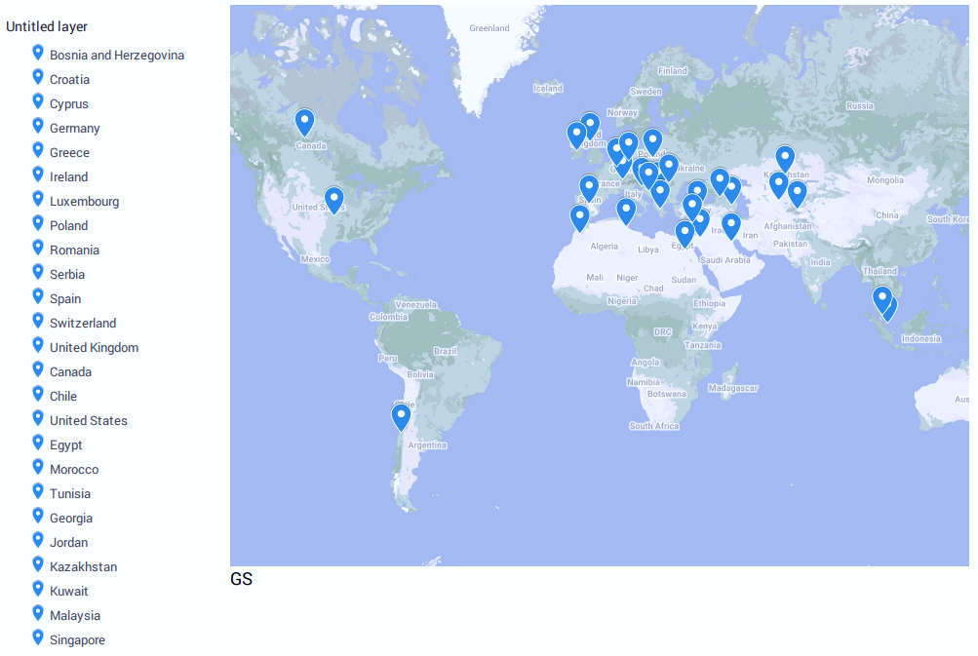
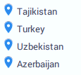
Global Sustain - Countries of Project Delivery
Europe
Americas
Africa
Last Update: March 2022
Asia

Slide 6
Learning Objectives
  Broaden your understanding of ESG, risks and opportunities.
  Explore how ESG impacts the bottom line of a business.
  Familiarise with ESG frameworks, principles, and standards.
  Get an update on ESG-related regulatory developments, trends and market practices.
  Learn about ESG integration into governance, strategy, policies and risk management.
  Find out why ESG due diligence is important for SMEs financing.

Slide 7
Part A
ESG overview and definition

Slide 8



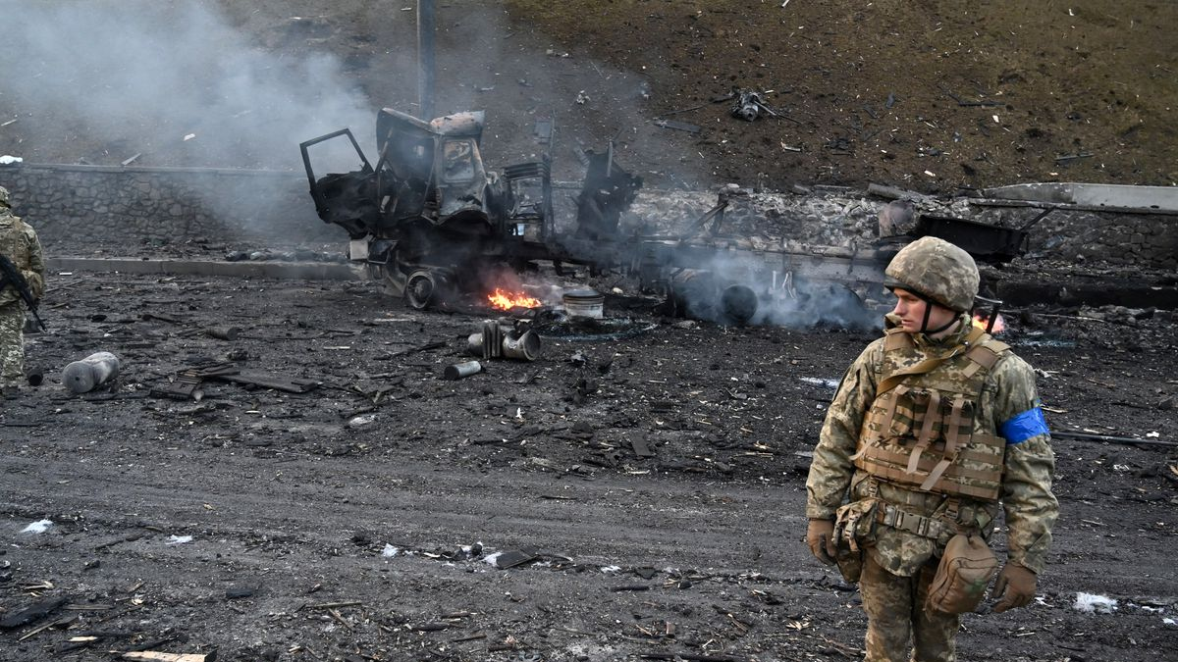
Global Sustainability Challenges

Slide 9
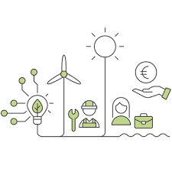

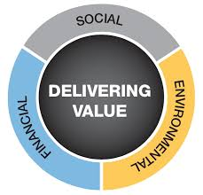


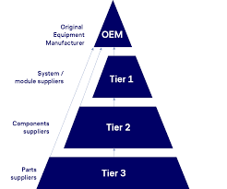


Key Sustainability Trends
Focusing on Business Resilience
Green Recovery
Increased Scrutiny on ESG Performance
Increased ESG Reporting requirements
ESG Rating
CCC | CC | C | B | BB | BBB | A | AA | AAA
Integrating
Climate Risk in ERM
Addressing ESG impact in global value chains (EU CSDD)
Sustainable Finance
for corporates and SMEs
ESG rating for firms
of all sizes

Slide 10
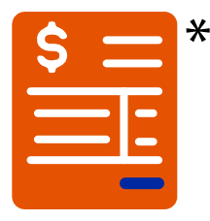
ESG – The New Common Language
ESG
Environment
Social
Governance

Slide 11
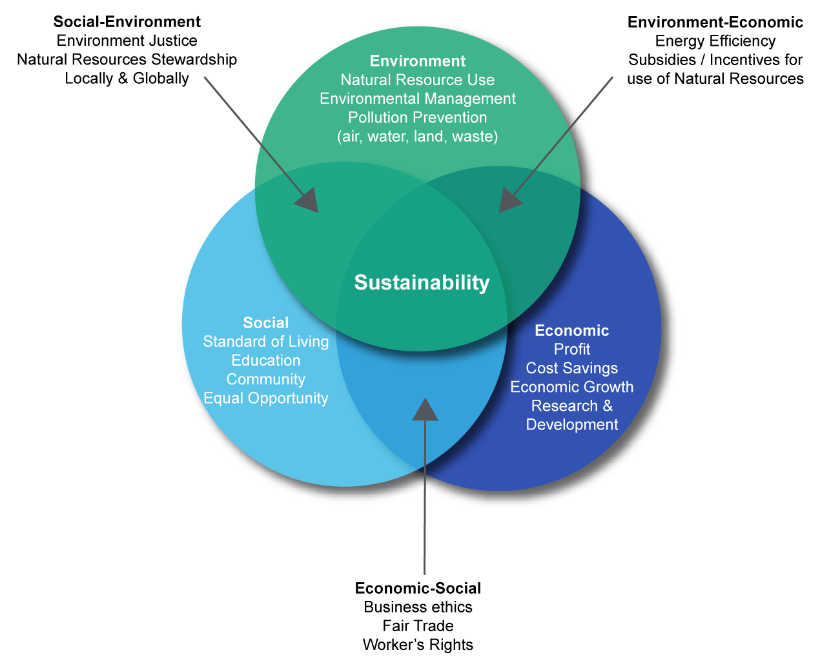

The Three Pillars of Sustainability
ECONOMY
ENVIRONMENT
PEOPLE

Slide 12
Regulatory Definition of Sustainable Investment
EU Sustainable Finance Disclosure Regulation (SFDR)
  Sustainable Investment means an investment in an economic activity that contributes to:
    An environmental objective (‘E’), as measured, for example, by key resource efficiency indicators on the use of energy, renewable energy, raw materials, water and land, on the production of waste, and greenhouse gas emissions, or on its impact on biodiversity and the circular economy,
    Or an investment in an economic activity that contributes to a social objective (‘S’), in particular an investment that contributes to tackling inequality or that fosters social cohesion, social integration and labour relations, or an investment in human capital or economically or socially disadvantaged communities, provided that such investments do not significantly harm any of those objectives
    And that the investee companies follow good governance practices (‘G’), in particular with respect to sound management structures, employee relations, remuneration of staff and tax compliance;
  Source: Regulation (EU) 2019/2088 of the European Parliament and of the Council of 27 November 2019 on sustainability‐related disclosures in the financial services sector. Article 2, par. 17

Slide 13
Cross-Industry ESG Material Issues
Environmental (E) | Social (S) | Governance (G)
Energy Efficiency | Employee Compensation | Board Independence
Carbon Emissions | Benefits | Director Compensation
GHG Emissions | Staff Turnover | Succession Planning
Biodiversity | Employee Health | Litigation Risks
Water Usage | Safety Practices and Targets | Corruption/ Bribery
Natural Resource Use | Training Hours | Codes of Conduct
Recycling Practices | Diversity and Targets | Transparency Policies
Waste Disposal | Local Community Support | Suppliers Code
(Source: PRI – Global Sustain)

Slide 14
Part A
ESG and the bottom line

Slide 15
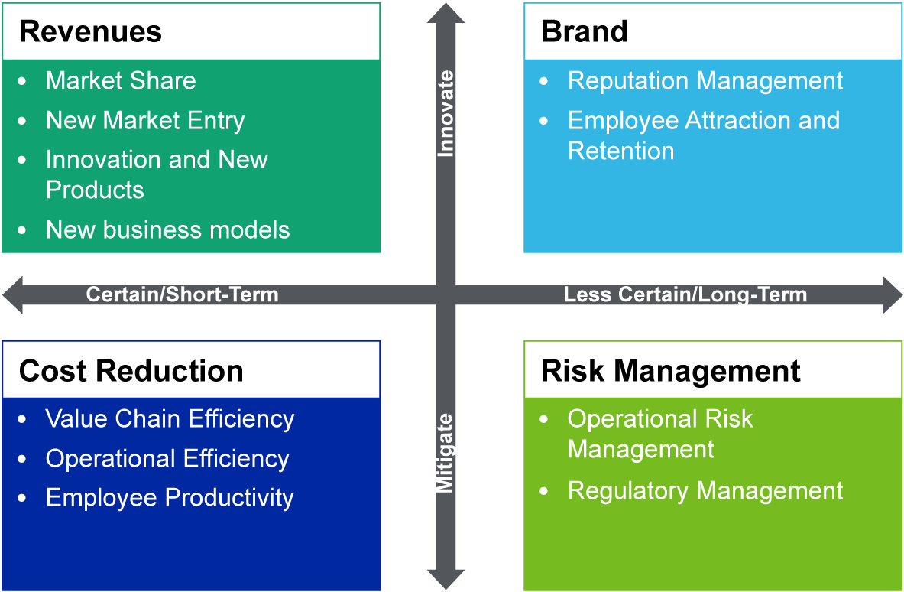
The Impact of ESG on the Bottom Line

Slide 16
ESG and the Bottom Line
Defining the KPIs
The most material figures (KPIs) that affect the bottom line of a company are:
The Revenue(s) (sales, turnover, income)
The Capital Expenditure or Expenses (CapEx)
The Operating Expenses (OpEx)
To understand how ESG factors affect these KPIs we need to analyse the following statements/accounts:
The Balance Sheet
The Income Statement (or Profit and Loss Account/Statement)
The Cash Flow Statement

Slide 17
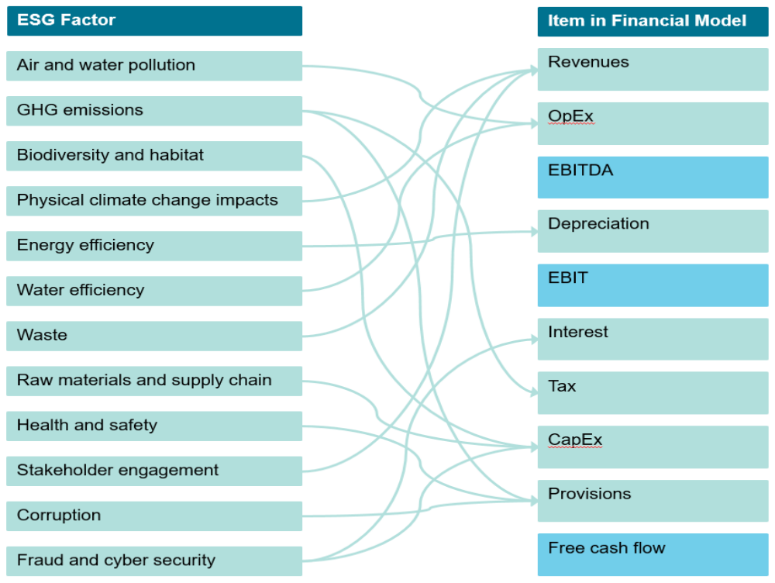
Case Study
Impact on:
  Revenues
  CapEx
  OpEx
  Provisions
  Interest rates
  Tax

Slide 18
Case Study: The Convenience Store
Energy Efficiency Improves the Bottom Line
Let’s review the impact of energy efficiency on an average mid-sized convenience store with turnover of €3m annually and a gross margin of 29%.
Using typical performance metrics for this industry it is fair to expect the business to be paying approximately €45k per annum in energy costs.
If the retailer decided to invest €25k in an LED lighting project with a simple payback of 2 years, it would result in a €12,500 annual saving that can flow straight to the bottom line.
To deliver that same level of EBITDA uplift through sales growth would require approximately an increase in turnover of €500k, which in a mature sector such as retail revenue uplifts of 17% is highly unlikely without very significant capital investment far in excess of the €25k energy efficiency project.

Slide 19
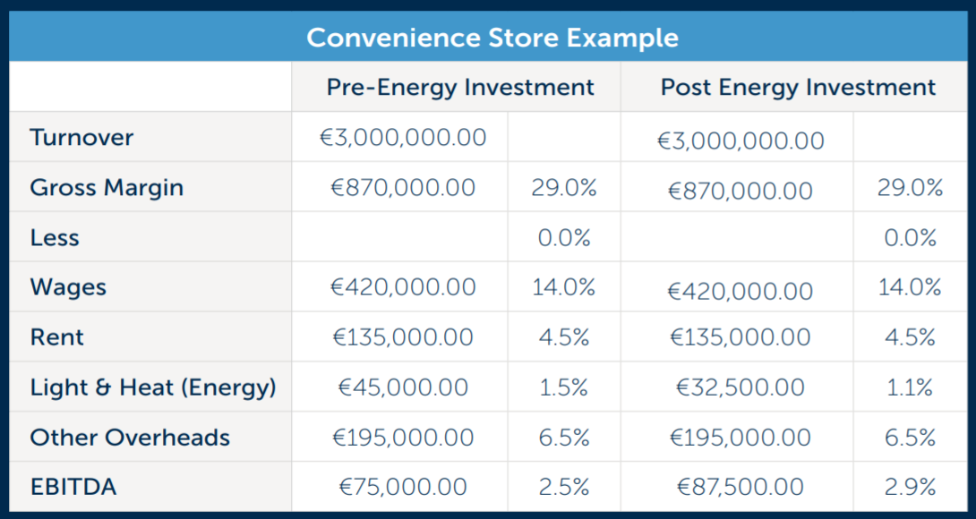
Case Study: The Convenience Store (continued)
Energy Efficiency Improves the Bottom Line

Slide 20
Part A
The ESG Ecosystem

Slide 21
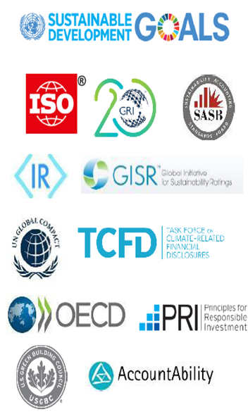
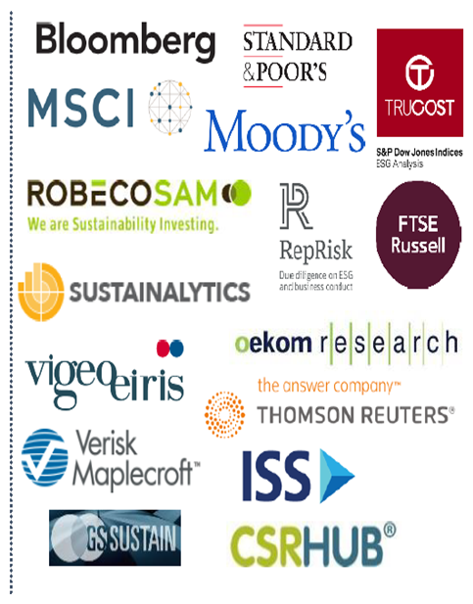


The ESG Ecosystem

Slide 22
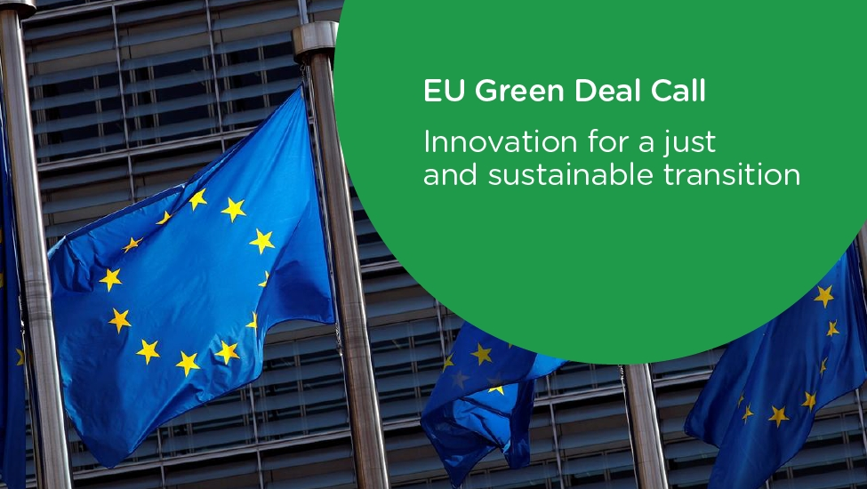



EUR 1 trillion in sustainable investments over the next decade.
Source: EC, Jan. 14, 2020

Slide 23
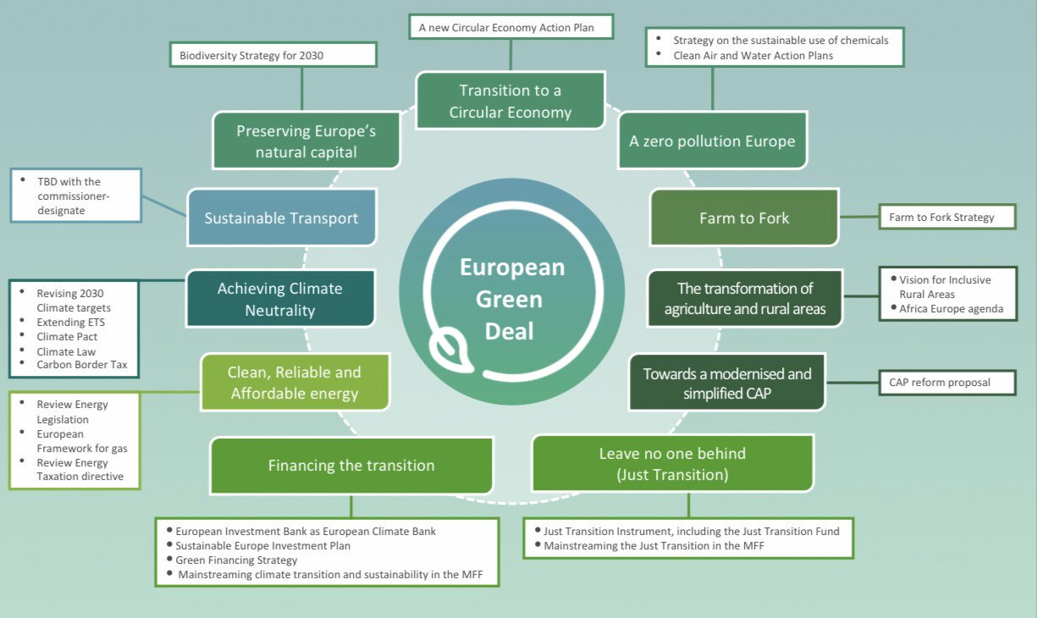

Slide 24
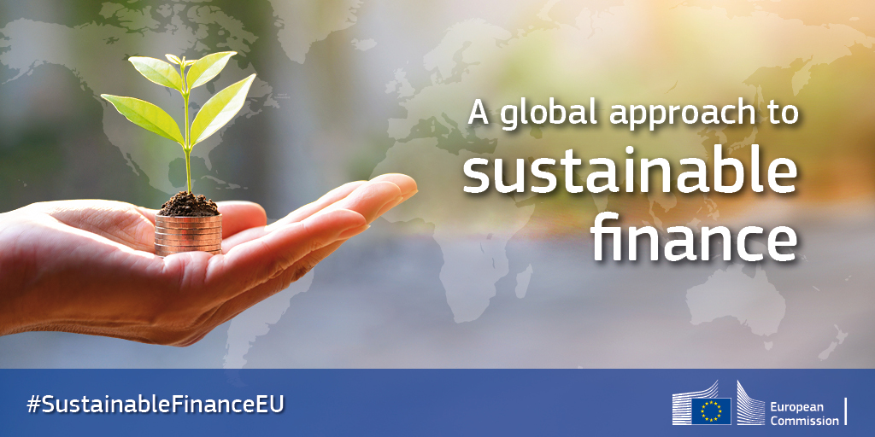
European Union Sustainable Finance ec.europa.eu

Slide 25
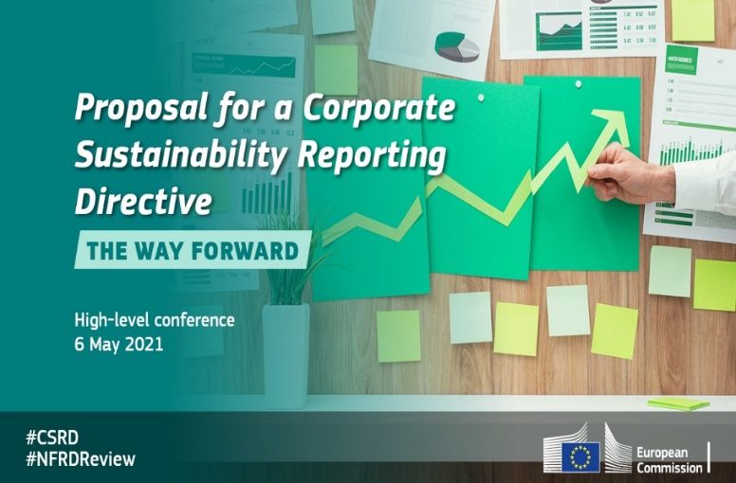

The Directives
Companies
Directive 2014/95/EU, the Non-Financial Reporting Directive.
The NFR Directive only applies to large public-interest companies with more than 500 employees in EU. This covers approximately 6,000 large companies and groups across the EU, including
listed companies | banks | insurance companies.
other companies designated by national authorities as public-interest entities.
On 10th of November 2022, the European Parliament adopted the Corporate Sustainability Reporting Directive (CSRD).
With the approval from the European Council on 28th of November 2022, the CSRD is now officially adopted into EU law. The provisions will be applicable in stages between 2024 and 2029:
  Stage 1 - Large public-interest companies within the scope of the NRFD from 1 January 2024, with reports due in 2025.
  Stage 2 - Large companies not within the scope of the NFRD from 1 January 2025, with reports due in 2026.
  Stage 3 - Listed SMEs and other undertakings from 1 January 2026, with reports due in 2027. SMEs can opt-out until 2028.
  Stage 4 - Non-EU companies from 1 January 2028, with reports due in 2029.
60,000
firms affected
The Commission's proposal for a Directive on corporate sustainability due diligence on human rights and the environment (the CSDD Directive).

Slide 26
The Regulations
Financial Markets
Regulation (EU) 2019/2089 as regards EU Climate Transition Benchmarks, EU Paris-aligned Benchmarks and sustainability-related disclosures for benchmarks (‘The Benchmarks Regulation’)
(Application date: 28 November 2019)
Regulation (EU) 2020/852 on the establishment of a framework to facilitate sustainable investment (‘The Taxonomy Regulation’)
(Application date: 12 July 2020, plus future dates)
Regulation (EU) 2019/2088 on sustainability‐related disclosures in the financial services sector (‘The Sustainable Finance Disclosure Regulation – SFDR’)
(Application date: 10 March 2021)

Slide 27
What the Taxonomy and SFDR mean for Companies
R&D&I to develop products and solutions that meet EU Taxonomy standards
Regulatory compliance challenges (mapping against NFR, SFDR, DNSH, GC, OECD…)
Financial/Accounting measurement challenges, i.e.:
  Align business activities with NACE codes (BICS, TRBC)
  Revenue from EU Taxonomy-aligned activities
  Capex from EU Taxonomy-aligned activities
  Opex from EU Taxonomy-aligned activities
Disclosure challenges (Annual Accounts? Sustainability Report?) for the RTS
Support/Finance transition to the low carbon economy (infrastructure/cites)
Support clients in a transition to a low carbon economy (Taxonomy-aligned activities)
Access to capital markets:
  Green Bonds
  Sustainability Linked Loans (SLLs)
  EU Taxonomy-aligned investment portfolios

Slide 28
ESG Frameworks, Principles, and Standards
CDP (formerly the Carbon Disclosure Project)
Climate Disclosure Standards Board
OECD Due Diligence Guidance for Responsible Supply Chains from Conflict-Affected and High-Risk areas, and the supplements to it
Eco-Management and Audit Scheme (EMAS) and the related Sectoral Reference Documents
The European Federation of Financial Analysts Societies’ KPIs for ESG, a Guideline for the Integration of ESG into Financial Analysis and Corporate Valuation
Global Reporting Initiative (GRI)
Guidance for Responsible Agricultural Supply Chains of FAO-OECD
Guidelines for Multinational Enterprises of the Organisation for Economic Cooperation and Development
Guiding Principles Reporting Framework on Business and Human Rights
ISO 26000 of the International Organisation for Standardisation
International Integrated Reporting Framework
Model Guidance on reporting ESG information to investors of the UN Sustainable Stock Exchanges Initiative
Natural Capital Protocol
Principles for Responsible Banking
Principles for Responsible Investment
Product and Organisation Environmental Footprint Guides
Sustainability Accounting Standards Board (SASB)
Task Force for Climate-related Financial Disclosures Recommendations (TCFD)
The Tripartite Declaration of principles concerning multinational enterprises and social policy of the ILO
United Nations (UN) Global Compact
UN Sustainable Development Goals
UN Guiding Principles on Business and Human Rights implementing the UN ‘Protect, Respect and Remedy’ Framework.

Slide 29
Part A
International Financial Institution (IFI) Standards & Requirements

Slide 30
IFI Standards
EBRD Performance Requirements
https://www.ebrd.com/environmental-and-social-policy.pdf
IFC Performance Standards
https://www.ifc.org/wps/wcm/connect/topics_ext_content/ifc_external_corporate_site/sustainability-at-ifc/publications/publications_handbook_pps
World Bank EHS Guidelines
https://www.ifc.org/wps/wcm/connect/topics_ext_content/ifc_external_corporate_site/sustainability-at-ifc/policies-standards/ehs-guidelines

Slide 31
Part B
ESG Governance

Slide 32
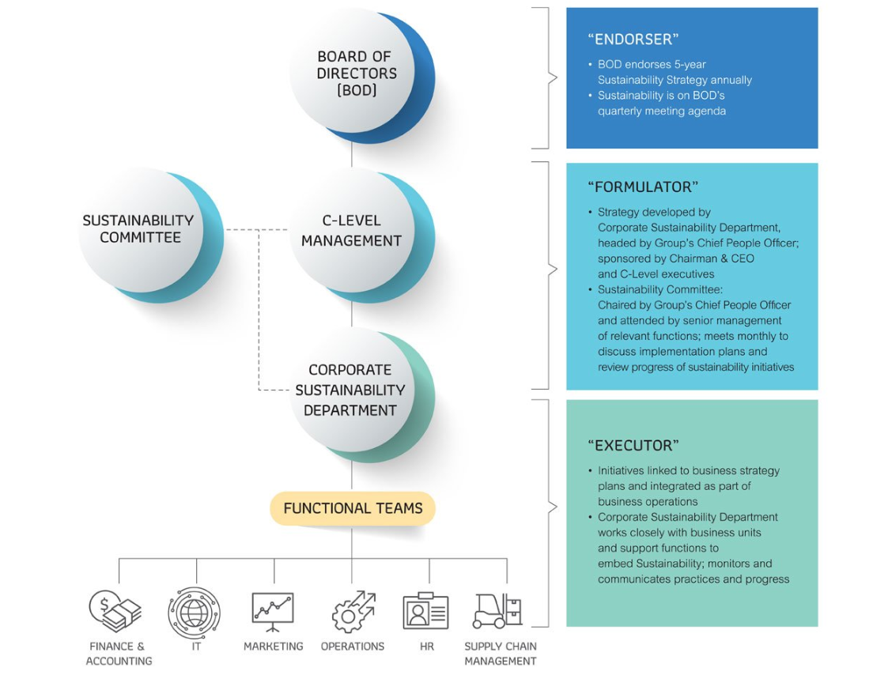
ESG Governance Structure
Hospitality and leisure company

Slide 33
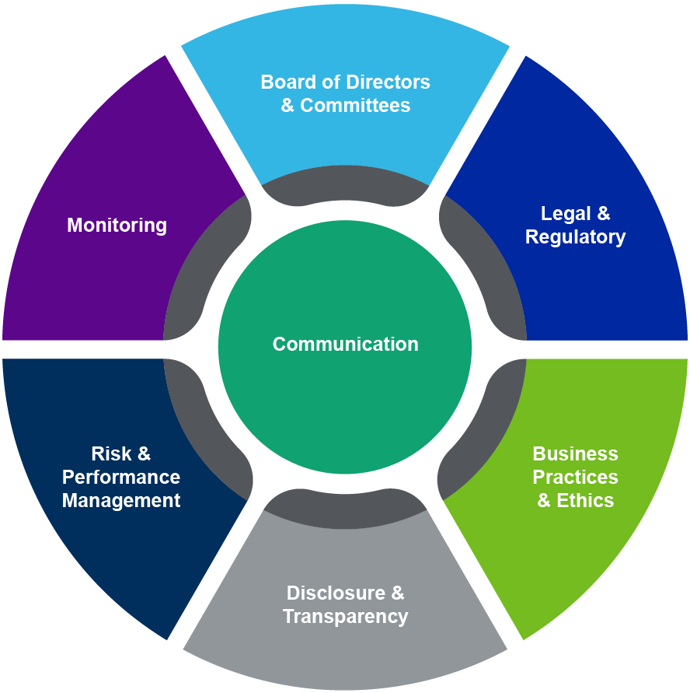
Corporate Governance & ESG
Communication is key

Slide 34


ESG/Sustainability Team Players
ESG/SUSTAINABILITY STRATEGY: 4 – 4 – 2
Environment
Management
Climate Change Strategy
Sustainable Products
& Services
Supply Chain
CSO
Social Innovation
Integrity
& Social
Reporting
Human Rights
Flagship Social Program
Health & Safety
Talent Management & Diversity

Slide 35
Case Studies:
ESG Governance

Slide 36


Case Study:
Project Title: Corporate Governance Framework
Date: 2021
Project Description:
A Corporate Governance Framework has been developed for Papoutsanis SA including management's oversight of ESG issues, processes and procedures for efficient governance due diligence and charters for several Board Committees.

Slide 37

Case Study:
Project Title: Climate Governance Enhancement
Date: April – July 2022
Project Description:
A Climate Governance Enhancement has been developed for a Bank Islam (Malaysia), to enhance their Climate Governance by developing climate governance structure, policies, methodologies, and tools.

Slide 38
Part B
ESG Strategy and Policy

Slide 39
The Sustainability Journey
The Sustainability Journey
RECOGNIZE
MANAGE
REPORT
INTEGRATE
OPTIMISE
SUSTAINABLE BUSINESS
Company’s:
Business Drivers
Vision
Objectives
Current Position
Sustainability Team
Measurement
Benchmarking
Training
International Standards International Guidelines
Materiality Analysis
Sustainability Strategy Pillars Objectives per Pillar
Priorities per Pillar Sustainability Policy
KPIs
Action Plan
(1-3 years sustainability initiatives)
Sustainable Business Models and Brands

Slide 40

10 Reasons Why SMEs need an ESG Strategy
  Improve business efficiency.
  Identify opportunities and risks.
  Link financial and non-financial performance.
  Establish long-term strategy and policy.
  Competitive differentiation.
  Compare performance internally, and between organizations and sectors.
  Keep employees and keep them engaged.
  Reputation management.
  Mitigate – or reverse – negative environmental, social and governance impacts.
  Enable external stakeholders to understand your true value, tangible and intangible assets.

Slide 41
Case Studies-
ESG Strategy and Policy Development

Slide 42

Case Study:
Project Title: ESG integration into Strategy, ESG Reporting, Training and Capacity Building for GEP
Date: 2016 - 2020
Project Description: Since 2016, GEP, an SME, has been improving ESG integration and disclosure through sustainability training, Annual Report 2016 Review – Annual Report, GRI and ISO 26000 (reporting period 2018 & 2019), Stakeholder Panel (engagement), Sustainable Development Strategy.

Slide 43

Case Study:
Project Title: EBRD's ESG Guide for SMEs
Date: August 2021 - March 2022
Project Description:
An ESG Guide for Small and Medium-sized Enterprises (SMEs) has been developed in cooperation with the European Bank for Reconstruction & Development (EBRD).
The ESG Guide for SMEs entails a 5-step roadmap with operating procedures, toolkits, checklists, and helpful study material that SMEs may use to integrate ESG into strategy, governance, risk management, and reporting practices. The ESG Guide for SMEs provides a customisable means for transferring ESG knowledge and know-how to SMEs of all sizes and levels of development and encouraging them to embark on their ESG journey.

Slide 44
Part B
ESG Risks & Opportunities

Slide 45
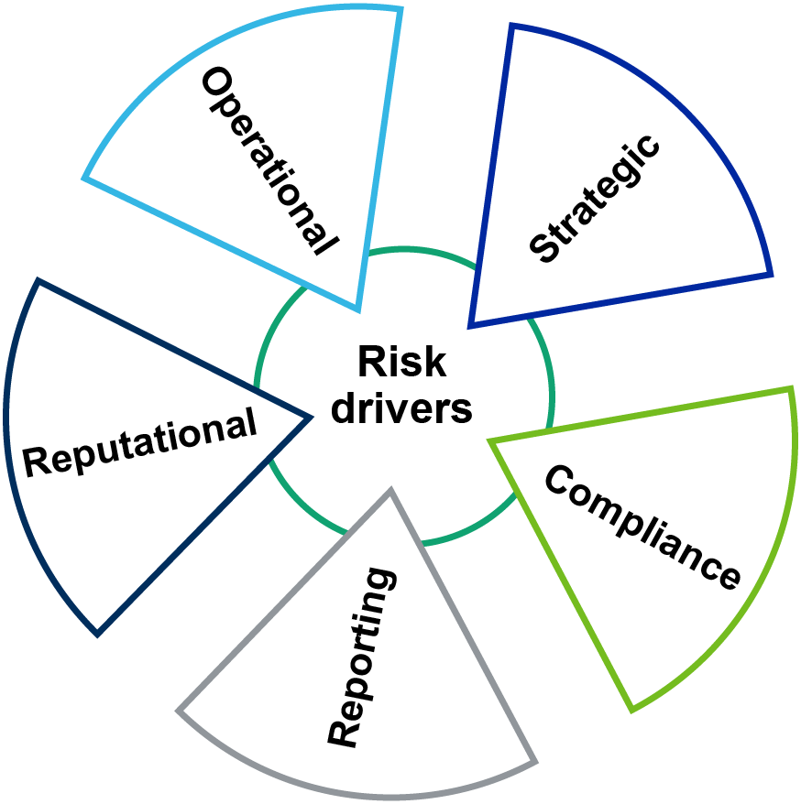
ESG and Risk Management
Redefining Risk Drivers

Slide 46
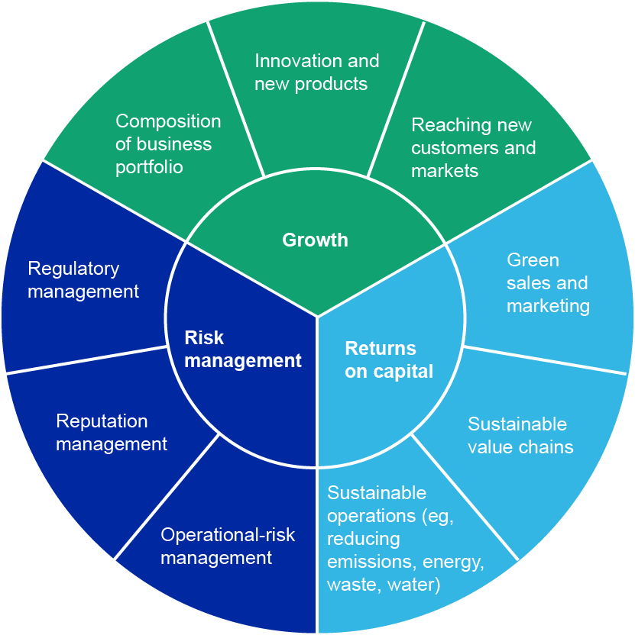
Risk – Return – Growth
The role of Sustainability

Slide 47
ESG risk drivers framework
Environmental Risk Drivers | Environmental strategy Pollution Biodiversity protection Water resource protection Environmental impacts on energy use Management of atmospheric emissions Waste management Local pollution management Management of environmental impacts from transportation. Transition climate risks Physical climate risks
The factors that drive Environmental risks can be classified into these categories:

Slide 48
ESG risk drivers framework
Social Risk Drivers | Social Dialogue Employee Participation Reorganization Career Management Remuneration Health & Safety Working Hours Information to Customers Customer Relations Suppler Relations Child & Forced Labour Social Standards in the Supply Chain Societal Impacts of Products & Services Philanthropy Fundamental Human Rights Non-Discrimination Child & Forced Labour Product Safety (S)
The factors that drive Social risks can be classified into these categories:

Slide 49
ESG risk drivers framework
The factors that drive Governance risks can be classified into these categories:
Governance Risk Drivers | Anti-Corruption Anti-Competitive Practices Environmental standards in the supply chain Responsible Lobbying Board of Directors Audit & Internal Controls Shareholders Executive Remuneration Product Safety (G)

Slide 50
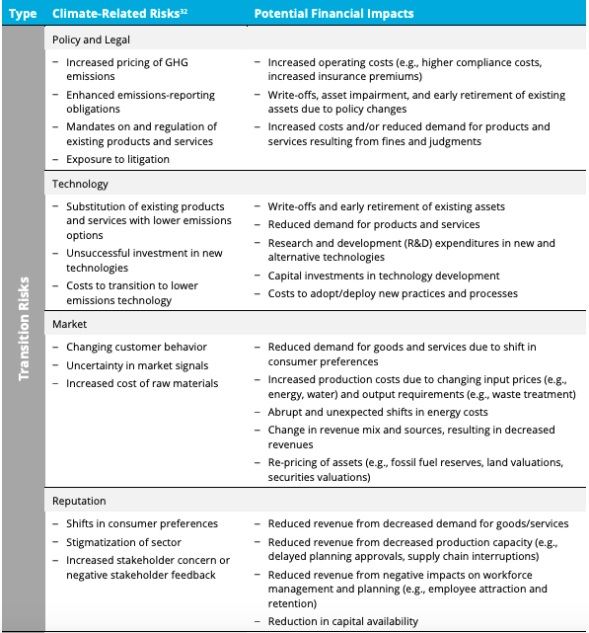
Climate Risks & Impacts

Slide 51
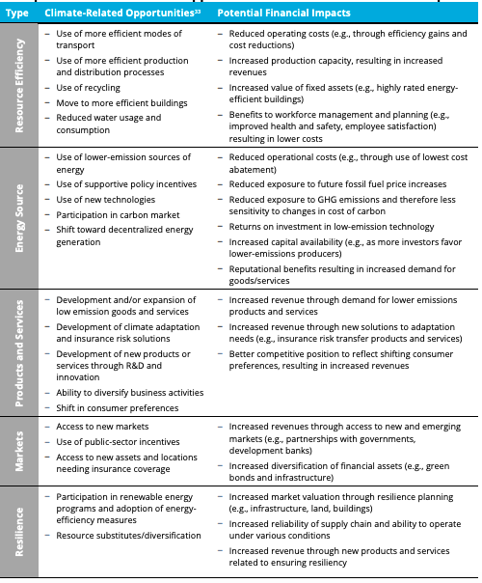
Climate Opportunities & Impacts

Slide 52
Part B
ESG Training & Capacity Building

Slide 53
Case Studies -
ESG Training & Capacity Building

Slide 54
Case Study:
Project Title: EBRD E&S Risk Management Training for FIs
Date: From September 2019 onwards
Project Description:
Since 2019, Global Sustain has developed the content, organised and delivered in collaboration with the EBRD trainings on ESG and Sustainable Finance in Bosnia & Herzegovina, Croatia, Egypt, Georgia, Georgia, Greece, Jordan, Kazakhstan, Morocco, Poland, Romania, Serbia, Tunisia, Turkey and Uzbekistan.

Slide 55
Case Study:
Project Title: EBRD ASB Programme- ESG Consulting and Training for SMEs
Date: From March 2020 onwards
Project Description:
Since 2020, Global Sustain, as a registered qualified EBRD Adviser for SMEs, has been assisting SMEs in developing ESG and sustainability strategies and policies, and delivering training on ESG to EBRD SME clients across EBRD countries of operations.
Advice for Small Businesses

Slide 56

Case Study:
Project Title: Delivery of ESG Project for the “Digital Academy for Business” of Eurobank
Date: June 2021 - March 2022
Project Description:
Four (4) training workshops were delivered delivered to over 330 SMEs companies in the context of the Digital Academy for Business of Eurobank. Relevant content has been also developed for the Digital Academy for Business of Eurobank, with the publication of 13 targeted articles in the section "ESG and Sustainability for the future of your business" available on Eurobank’s website. The articles are addressed to business owners or executives interested in learning more about the sustainability journey.

Slide 57


Case Study:
Project Title: TCFD Training
Date: 10 –13 March 2022
Project Description:
A 3-day training course on the Task Force on Climate-related Financial Disclosures (TCFD) was delivered to over 200 participants including SMEs, corporations, financial institutions, regulators, and NGOs.
The 3-day TCFD Training covered the following five comprehensive modules, including case studies, live polls, and group exercises:
Introduction to TCFD, TCFD adoption across the world, TCFD and the Banking Sector, TCFD and the Investments Sector, Reporting on TCFD

Slide 58
Part B
ESG Reporting

Slide 59
ESG Reporting
EBRD clients typically report annually to EBRD and external stakeholders through the following methods:
For EBRD Purposes
    Through the Annual Environmental and Social Report (AESR)
For External Stakeholders:
    Through Annual ESG/Sustainability Reports that follow international standards (i.e. GRI, CDP, UN Global Compact COP and TCFD).

Slide 60
Principles of Good ESG Reporting
Relevant for reporting and communication with both EBRD and other external stakeholders:
Report on material issues.
Ensure that these include issues material to stakeholders.
Identify Key Performance Indicators that track performance on these.
Set performance targets and report against these.
Ensure reporting is balanced and reflects positive and negative aspects.
Be consistent – select, compile and report information consistently.
Report accurately.
Reporting to EBRD: use the EBRD Annual E&S Report template agreed with EBRD.
New electronic reporting under development.

Slide 61
Part B
ESG Digitilisation

Slide 62
Case Studies -
ESG Digitilisation

Slide 63
Case Study:
Project Title: E&S Risk Management Digital Application for FIs and Private Equity Funds
Date: May 2020 - May 2021
Project Description:
Global Sustain supervised and led the development of a digital application on E&S Risk Management for FIs and Private Equity Funds, including screening against Exclusion and Referral lists, risk categorisation, E&S Due Diligence questionnaires and compliance check, E&S site visit checklist, ESDD report generator and E&S Action Plans.

Slide 64
Case Study:
Project Title: Environmental and Social Risk Management e-Learning Training Programme
for Financial Intermediaries
Date: From June 2021 onwards
Project Description:
Global Sustain developed and designed for the EBRD the “Environmental and Social Risk Management e-Learning Training Programme for EBRD’s partner Financial Intermediaries. It comprises 13 modules designed to cover the essential ESG knowledge for Financial Intermediaries (including banks, leasing and insurance companies, as well as private equity funds) with over 12 hours of content, a final exam and a certificate of completion.
For more information, please visit: https://ebrd.talentlms.com/index

Slide 65
Part C
Sustainable Finance

Slide 66
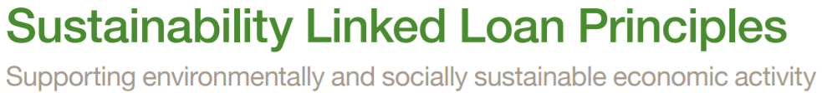
Sustainability Linked Loan Principles
1. Selection of Key Performance Indicators (KPIs)
2. Calibration of Sustainable Performance Targets (SPTs)
3. Loan Characteristics
4. Reporting
5. Verification

Slide 67
SLLs – Advantages
Advantages of SLL Products
Borrower | Lender
Incentives for lower interest rate with parallel increase in sustainability performance and reputation. Improvement of sustainability performance which leads to lower risk, to better credit risk rating for the borrower and improved conditions in the future credits. Improvement of sustainability performance leads to higher attractiveness of the company towards investors and access to capital. | Lower credit risk. Diversification. Higher reputation. Financial and banking innovation. Improvement of product portfolio and the product image. Increase clients base. Contribution to the achievement of the sustainability goals of the bank.

Slide 68
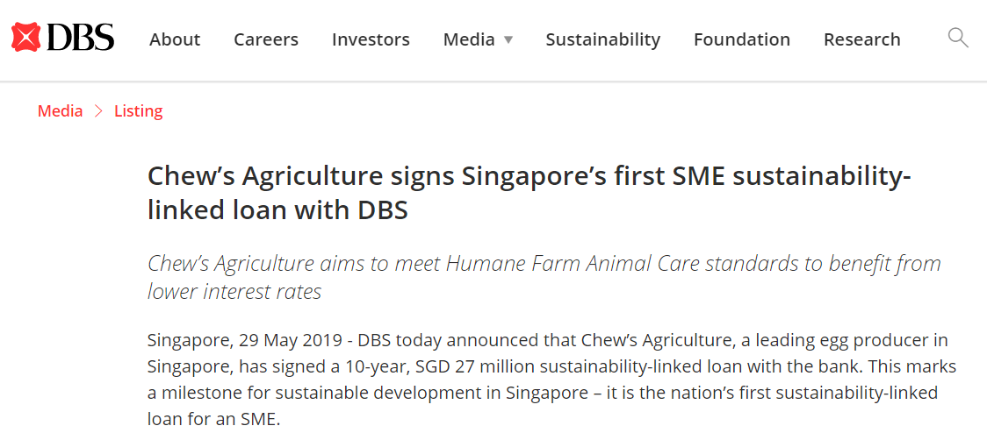
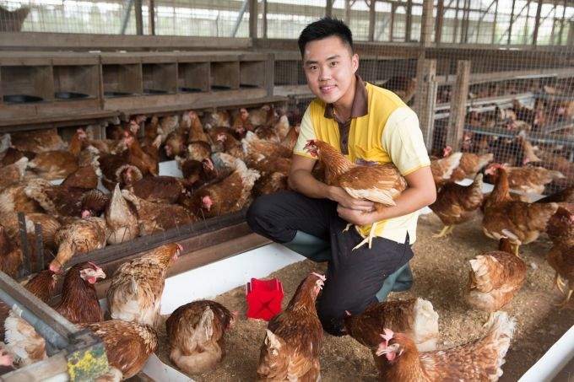
Sustainability Linked Loan – Case Study

Slide 69
Part C
E&S Due Diligence and Monitoring

Slide 70
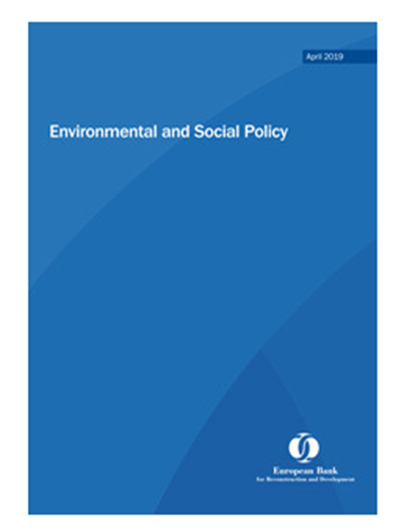
EBRD Environmental and Social Policy (“The ESP”)
EBRD has defined 10 Performance Requirements (PRs)
All PRs are applicable to funds and their investments:
PR 1 | Assessment and Management of Environmental and Social Impacts and Issues (Management Systems).
PR 2 | Labour & Working Conditions.
PR 3 | Resource Efficiency and Pollution Prevention and Control.
PR 4 | Health and Safety.
PR 5 | Land Acquisition, Involuntary Resettlement and Economic Displacement.
PR 6 | Biodiversity Conservation & Sustainable Management of Living Natural Resources.
PR 7 | Indigenous Peoples.
PR 8 | Cultural Heritage.
PR 9 | Financial Intermediaries.
PR 10 | Information disclosure and stakeholder engagement.
http://www.ebrd.com/news/publications/policies/environmental-and-social-policy-esp.html
70

Slide 71

How EBRD conducts ESDD for SMEs
Case Study- Az-Lead LLC
The EBRD will provide a loan to an SME in Azerbaijan which produces secondary refined lead via the recycling of end-of-life lead-acid batteries. The Project will finance the Company's increase in secondary lead production capacity, increase lead recovery rates and improve the overall environmental and energy efficiency performance of Az-Lead. Furthermore, the Bank's engagement has introduced ESG undertakings that represent best practice for SMEs in the EBRD region.
The Bank engaged Global Sustain to carry out an E&S audit and assessment of the Company.
Based on the results of the E&S Assessment, Global Sustain has documented all significant E&S issues and developed an E&S Due Diligence Report (ESDD), an Environmental & Social Action Plan (ESAP) and a Stakeholder Engagement Plan (SEP).
  The ESDD Report identifies improvement needs in the Company’s management practices to be in line with the procedures and EBRD’s Performance Requirements and EU Best Available Techniques (BAT).
  The ESAP defines actions to be implemented after the Project expansion to improve environmental performance and address H&S issues.
  The SEP includes stakeholder engagement activities and describes the internal and external actions and grievance procedure before, during, and after the Project.
For more information: https://www.ebrd.com/work-with-us/projects/psd/53479.html https://www.ebrd.com/work-with-us/projects/psd/53479.html

Slide 72

Q&A
Lead sustainable change for a better future.

Slide 73
Training Evaluation
Please complete the evaluation before leaving the meeting room.

Slide 74
Copyright © 2022 – Global Sustain
All rights reserved.
This material is for the designated recipient(s) only and may contain privileged, proprietary, or otherwise private information. Any other use of this proposal without written consent of Global Sustain is prohibited. Where allowed by local law, communications with Global Sustain and its affiliates, including, mail (post), e-mail and instant messaging (including content), may be scanned by our systems for the purposes of information security and assessment of internal compliance with Global Sustain policy.
Global Sustain is a registered trademark TM.
www.globalsustaingroup.com | info@globalsustain.org

