Slide 1
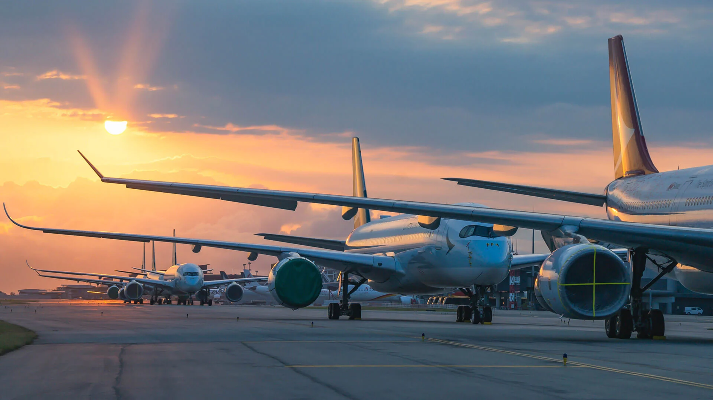
Academy 101 – Ishka India

Slide 2


 | Stake holders Aircraft Overview ESG Considerations
 | Overview of Aviation

Slide 3















  Formation of an Aviation Ecosystem
Primary
Airports
Airlines
Secondary
Logistics
Training
Travel Agents
MRO
Lessors
High Value Mfg.
Tertiary
Education
Exports
Construction
Tourism
Increase Trade Intensity
International Goodwill & Branding
Boost to Economy

Slide 4
  Aviation allows people from different cultures and backgrounds to interact, learn from each other, and build mutual understanding.
Emergency and Humanitarian Aid
Air transport is often the fastest way to deliver aid and medical supplies to areas affected by natural disasters, conflicts, or health crises.
  Innovation and Technological Advancements
  The industry has been a catalyst for technological innovations, many of which have broader applications beyond aviation.
    GPS and Navigation Technology.
    Material Science.
    Satellite Technology.
    Safety Technologies
Access to Remote Areas
Aviation provides access to remote and isolated regions, which is vital for their development and integration into the global economy.
A study by the International Air Transport Association (IATA) found that the average multiplier effect for an aviation route is 2.4. This means that for every $1 spent on air travel, an additional $2.4 is generated in economic activity.
Cultural and Educational Tourism
By making travel more accessible, aviation has significantly contributed to cultural and educational tourism.
This not only boosts local economies but also fosters a greater appreciation of cultural heritage and natural wonders around the world.

Slide 5
  Airplane Evolution (Narrow Bodies / Wide Bodies)
Aircraft | Max Seats | MTOW (lb/kg) | Range (nm/km) | Max Mach | Length (ft in/m) | Wingspan (ft in/m)
Widebody Aircraft
Airbus A330-300 | 440 | 533,500/242,000 | 6350/11,750 | M0.86 | 208 ft 10 in/63.66 | 197 ft 10 in/60.3
Airbus A350-900 | 400 | 617,290/280,000 | 8100/15,000 | M0.89 | 219 ft 2 in/66.08 | 212 ft 5 in/64.75
Boeing 767-400ER | 409 | 450,000/204,116 | 5625/10,415 | M0.86 | 201 ft 4 in/61.37 | 170 ft 4 in/51.92
Boeing 787-9 | 406 | 560,000/254,011 | 6430/11,908 | M0.90 | 224 ft/68.28 | 197 ft 3 in/60.12
Airbus A350-1000 | 440 | 676,000/308,000 | 7950/14,750 | M0.89 | 242 ft 1 in/73.79 | 212 ft 5 in/64.75
Airbus A380 | 853 | 1268,000/575,000 | 8200/15,200 | M0.89 | 238 ft 7 in/72.2 | 261 ft 8 in/79.75
Boeing 747-8 | 605 | 987,000/447,696 | 8000/14,816 | M0.90 | 250 ft 2 in/76.3 | 224 ft 5 in/68.4
Boeing 777-300ER | 396 | 775,000/351,533 | 7370/13,649 | M0.89 | 242 ft 4 in/73.9 | 212 ft 7 in/64.8
Narrow Body Aircraft
Airbus A320ceo | 186 | 172,000/78,000 | 3300/6100 | M0.82 | 123 ft 3 in/37.57 | 117 ft 5 in/35.8
Boeing 737-800 | 189 | 174,200/79,016 | 2935/5436 | M0.82 | 129 ft 6 in/39.5 | 117 ft 5 in/35.8
Boeing 757-200 | 239 | 255,000/115,660 | 3915/7250 | M0.86 | 155 ft 3 in/47.3 | 124 ft 10 in/38.0
Airbus A220-100 | 160 | 149,000/67,585 | 3300/6112 | M0.82 | 127 ft 0 in/38.7 | 115 ft 1 in/35.1
COMAC C919 | 168 | 159,835/72,500 | 2200/4075 | M0.785 | 127.6 ft/38.9 | 117.5 ft/35.8

Slide 6
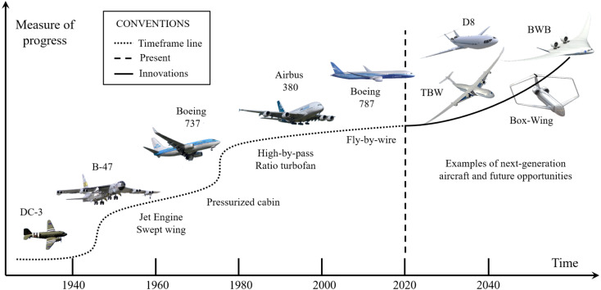
  Airplane Evolution
Early changes to aircraft structure focused on the perfection of the techniques and methods of flight.
Later, engineering moved on to being driven by trends in the market and airline capacity needs, looking to increase profitability and efficiency.
As we move ahead, these considerations continue to take center stage - but with the added complexity of decarbonizing the fuel source.

Slide 7
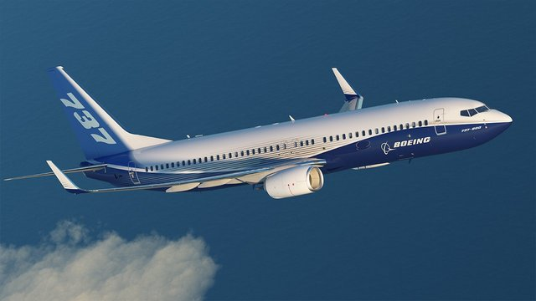

Slide 8
  Airplane Evolution
Following its success with the 707 and 727, Boeing designed a new aircraft B737 to beat the competition and win customers. The aircraft launched in 1967 and offered several design differences setting it apart from competitors
The 737 has remained in the market since 1967, moving through many variants. Each of these has offered updates to meet airline preferences and demands. The Boeing 737 has been the most sold aircraft to date.
The other significant change since the early jet aircraft was the development of larger aircraft. The best example here is the launch of the Boeing 747 in 1970, which was the best-selling widebody, having sold 1,768 copies across all variants, before it was passed by the 777, which, including the forthcoming 777X, has amassed 2,352 orders.
A major focus of the past couple of decades has been on improving airplane efficiency. Many of the early achievements were fantastic, but resulted in heavy aircraft, fuel-hungry engines, and high levels of emissions. As technology has improved and attitudes towards carbon footprints have shifted, manufacturers have focused on making change to reduce fuel burn.

Slide 9
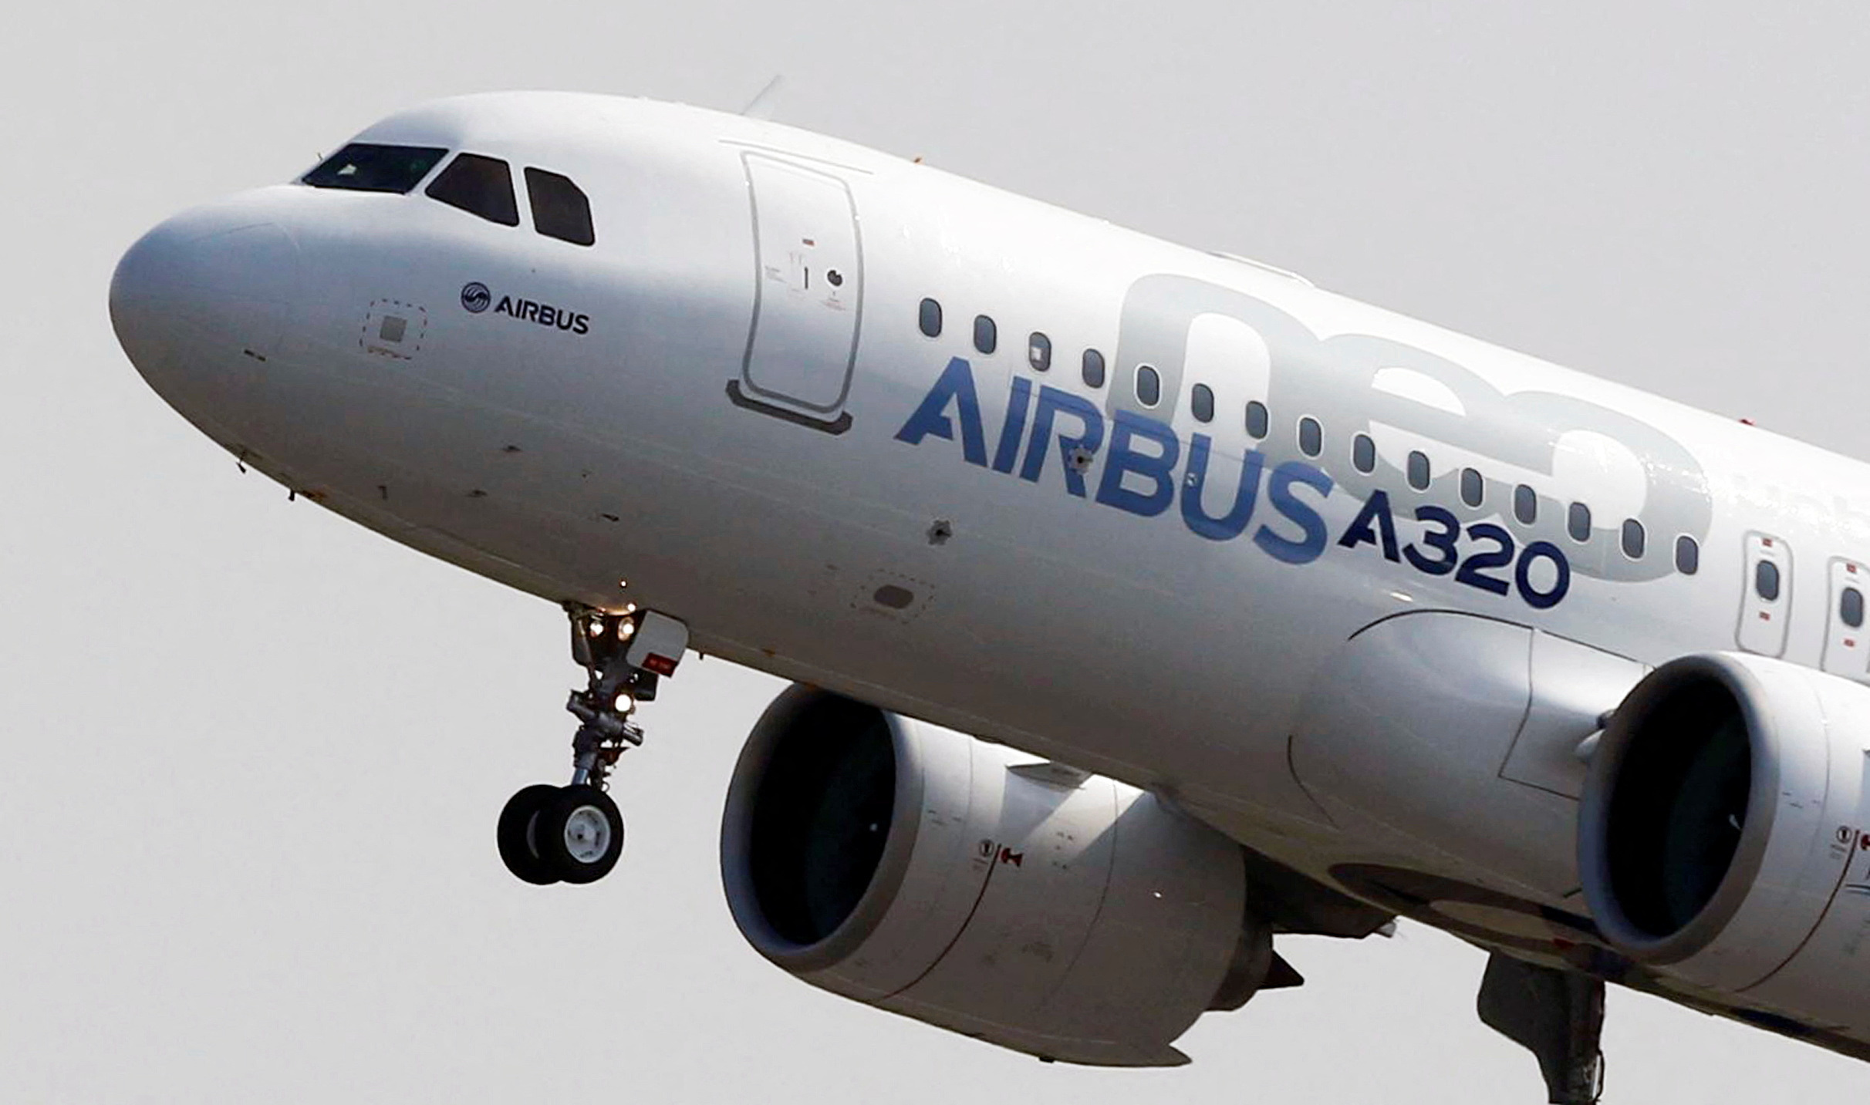

Slide 10
  Airplane Evolution
Airbus has followed a similar strategy with its A320 family. Since the launch in 1987, Airbus has offered several different-sized variants and evolved these to provide technology and efficiency upgrades, including the latest addition of the new engine option, or neo, offering approximately 15% better fuel efficiency than the current engine option, or ceo.
Aircraft size limits would not be pushed so far again until the development of the Airbus A380. Airbus looked at various versions of a large aircraft, including an interesting design of combining two large fuselages side by side (based on the A340). This eventually led to the concept of a two-deck aircraft. The A380 was formally announced at the Farnborough Air Show in 1990.
The A380 received 251 orders before production wound down, with the final A380 rolling out of Airbus' facilities in Toulouse in December 2021. The idea at the time of launch was that airlines would use it for high-capacity, hub-to-hub routes. It also carries one significant design limitation: its size and large wingspan severely limit the airports to which it can operate.
The A350 was improved, making way for significant improvements in much more efficient and cost-effective twins.

Slide 11
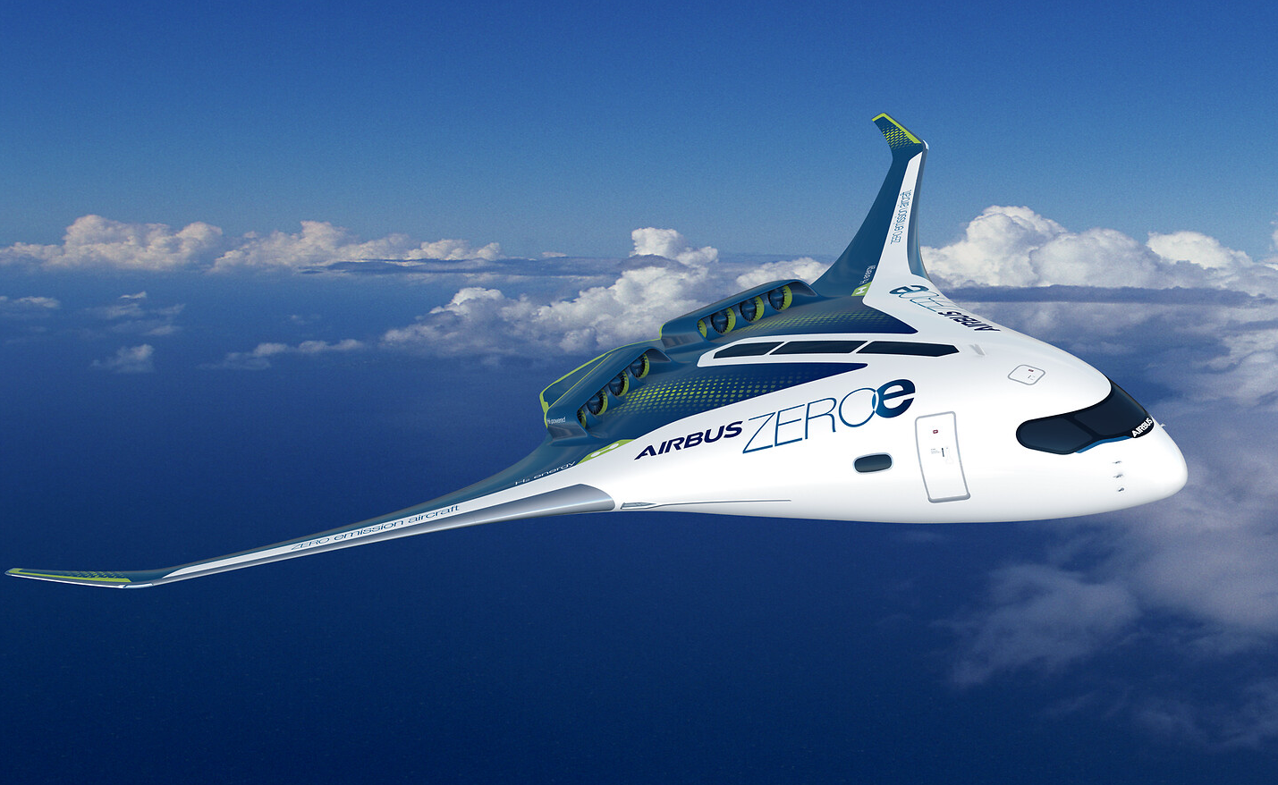

Slide 12
  Airplane Evolution
Options currently being explored and developed include battery technology and hydrogen power. The scaling of sustainable aviation fuel is one of aviation's best bets in slashing CO2 emissions, but it can be used with current technology aircraft and engines.
Hydrogen-electric fuel cells may be retrofitted onto planes the size of a Dash 8 by 2026, and electric aircraft carrying 30 passengers are predicted to enter service a couple of years later.
Airbus are working on a hydrogen-powered medium-sized jet ready by 2035. Blended-wing planes may prove to be another exciting development yet.
Both electric and hydrogen technology come with a fair amount of challenges, but initiatives and investments are beginning to pick up, for hydrogen-electric fuel cells as well as electric planes, including eVTOLs (Electric Vertical Takeoff and Landing vehicles).

Slide 13
  ESG Considerations
Improved Technology
Engine design
Aircraft Operations
Efficiency of operations
Infrastructure
Improved Air traffic management
Global Economic measure
Development in aerodynamics
Sustainable fuels
Ground Airport infra improvements
To agree to globally agreed mechanism that uses market structures to implement overall emission gap.
In 2009, IATA established an ambitious set of targets to limit and reduce the industry's impact on climate change through carbon dioxide emissions.
The three targets were: an average improvement in fuel efficiency of 1.5% pa from 2009 to 2020; a cap on net aviation CO₂ emissions from 2020 (carbon-neutral growth); and a 50% reduction in net aviation CO₂ emissions by 2050, relative to 2005 levels.

Slide 14



  ESG Considerations
Environmental – climate change, pollution, raw material use, energy efficiency and recycling practices. An example of an environmental factor for airlines includes carbon emissions from its fleet.
Social – employee rights, employee engagement and turnover, health and safety, satisfaction (both employee and customer), equality, transparency, gender and diversity, supply chain and procurement. An example of a social factor for an airline would include health and safety policy for its engineers working in the aircraft maintenance division or in the airline’s maintenance hangers.
Governance – management compensation, bribery, corruption, whistle blowing schemes and whistle blower protection, lobbying and political influence. An example of a governance factor for an airline would include dealing with regulators and safety auditors in a transparent manner.

Slide 15
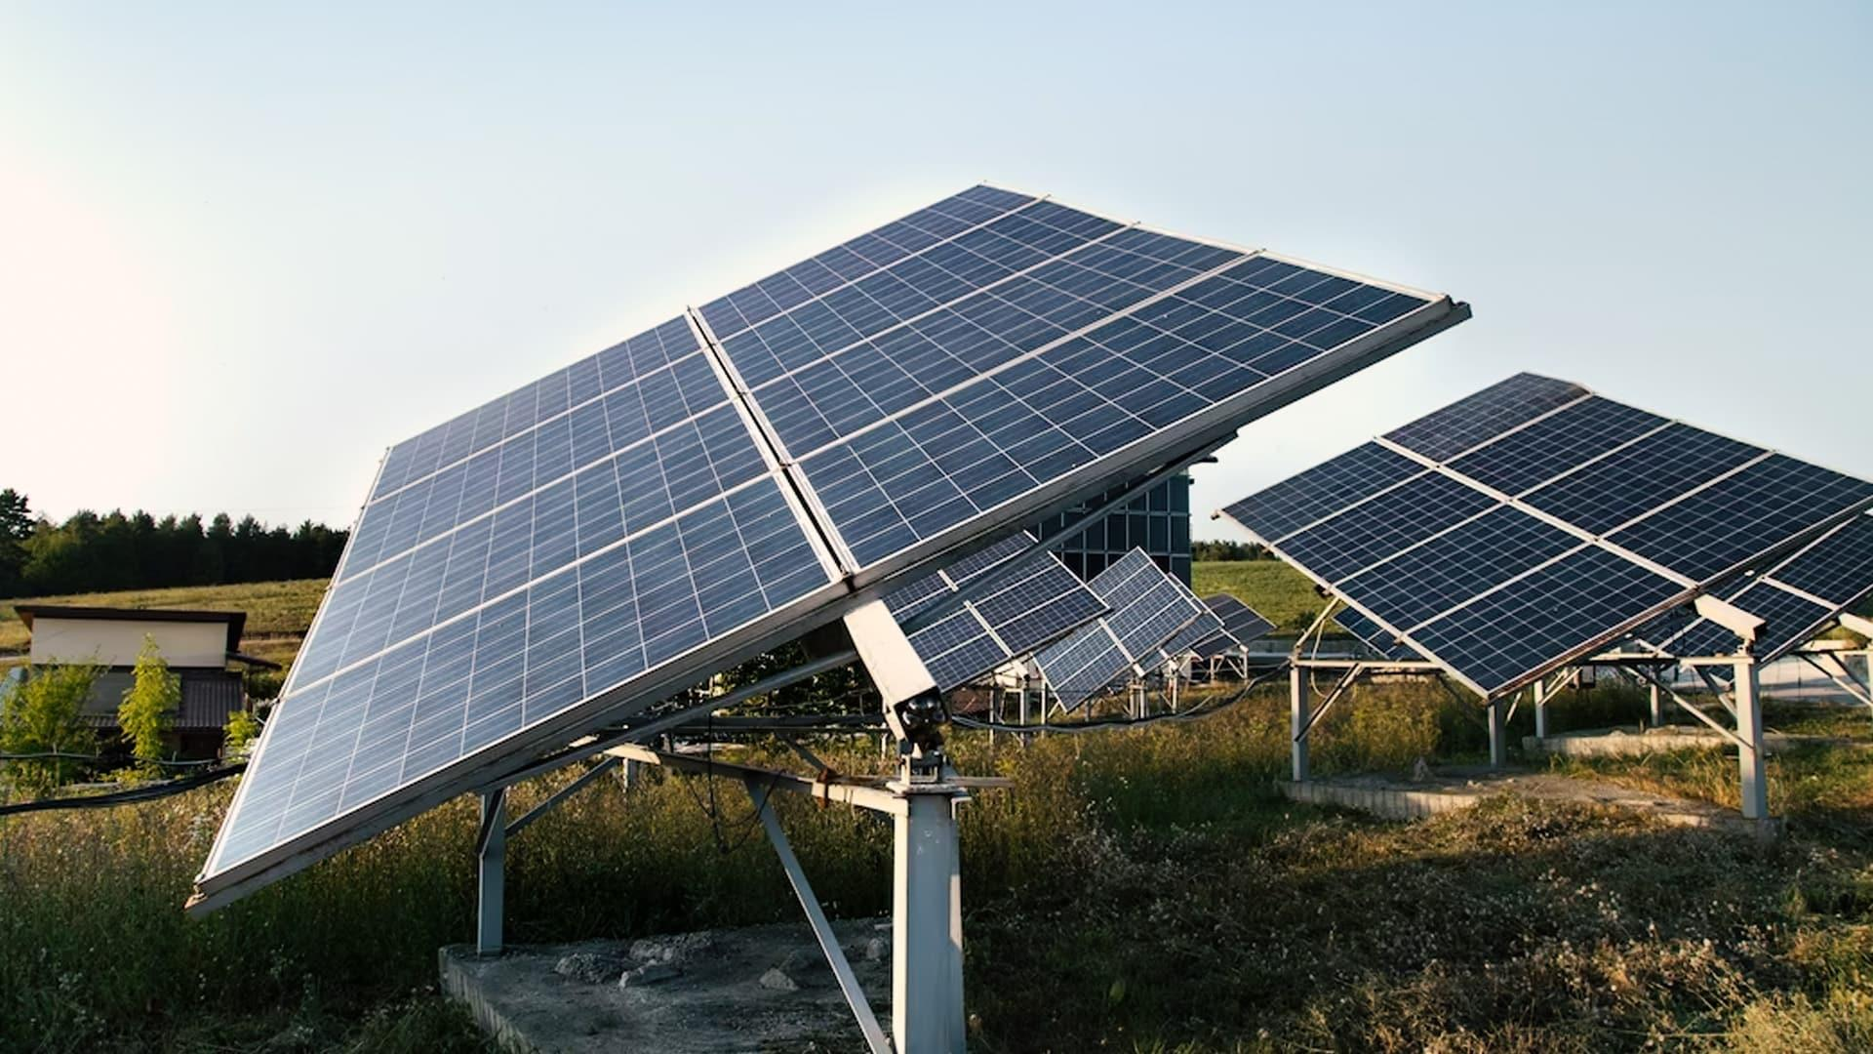



  ESG Considerations
ESG Financing
Green ESG
Social ESG
Sustainability ESG
Sustainability-Linked ESG
Green ESGs are for those that require funds from lenders to be used for a specific sustainable purpose or project.
Funds used for purposes or projects falling under the ‘social’ category is called Social ESGs instead of Green ESGs.
Similar to Green and Social ESGs, these involve utilization of funds for projects with a combination of green and social elements.
Sustainability-Linked ESGs are not tied to a specific project. Rather the financing terms are linked to the borrower’s performance against sustainable performance targets. The borrower has pre-determined sustainability targets measured by pre-established KPIs. The performance of the borrower on those targets drives the financing terms / costs.

Slide 16
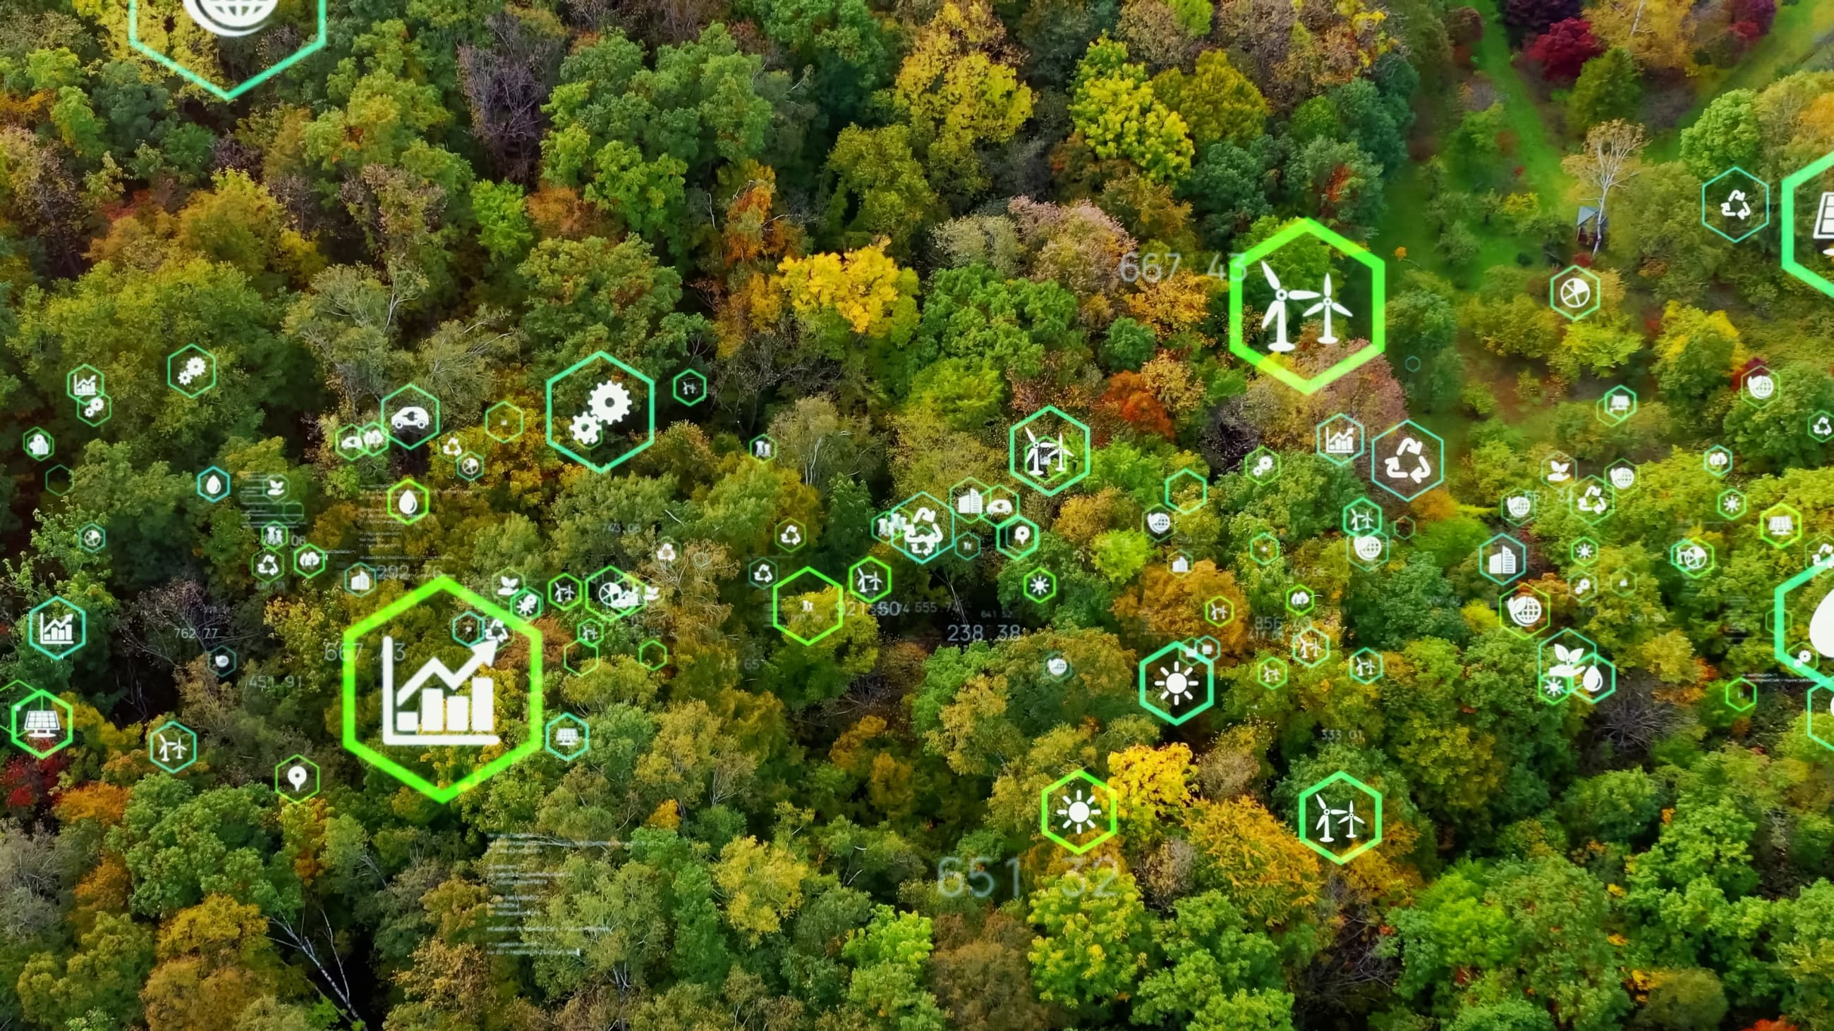
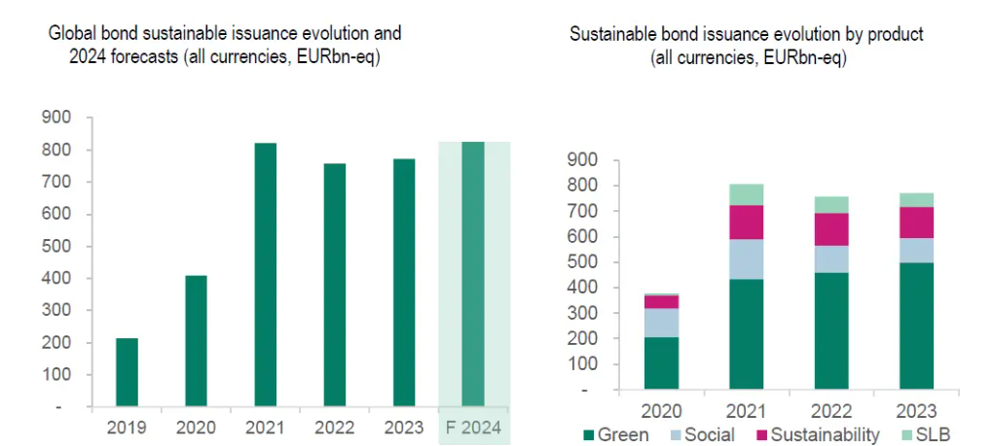
ESG investing has seen steady growth in demand over the past decade. The first phase of sustainable investing began in 1995.
Over the past five to seven years, a true mainstream phase of ESG investing and growth has emerged.

Slide 17
 | Passenger Traffic Airlines &Aircraft Orders Recent developments
 | Indian Aviation Industry

Slide 18
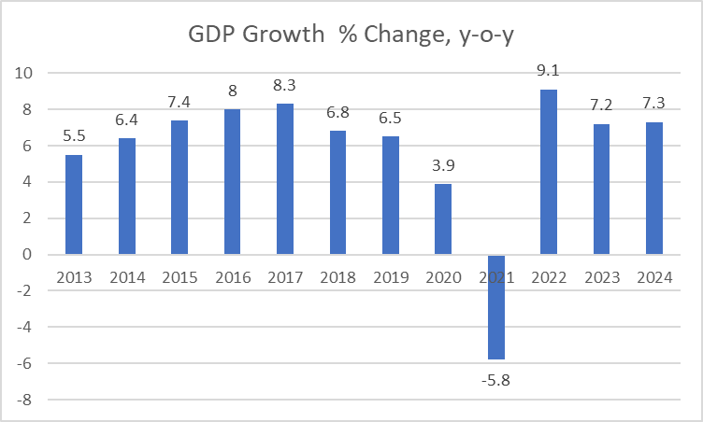
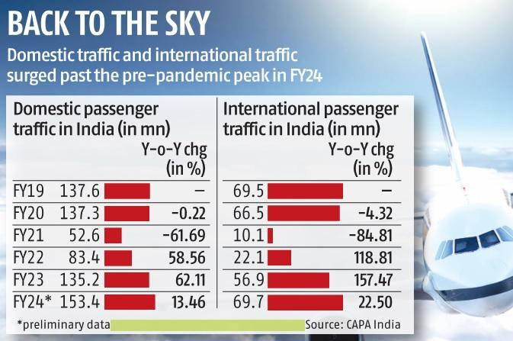
  Passenger Growth
In 10 years, India has moved from the 10th largest economy of the world to the 5th largest economy of the world.
India’s GDP Growth rate in the last 10 years has been at an average Growth rate of 6-7 per cent. From 2006 to 2023, India averaged 6.15 per cent.
The most important and the fastest growing sector of Indian economy are services. Trade, hotels, transport and communication; financing, insurance, real estate and business services and community, social and personal services account for more than 60 percent of GDP.
The domestic and international air traffic in India crossed the pre-pandemic peak of 2018-19 in 2023-24 due to sustained increase in demand.
International air traffic in India saw faster growth than domestic air traffic in 2023-24. The international air traffic in the country stood at 69.7 million passengers in 2023-24, recording a 22.5 percent year-on-year (YoY) growth.

Slide 19
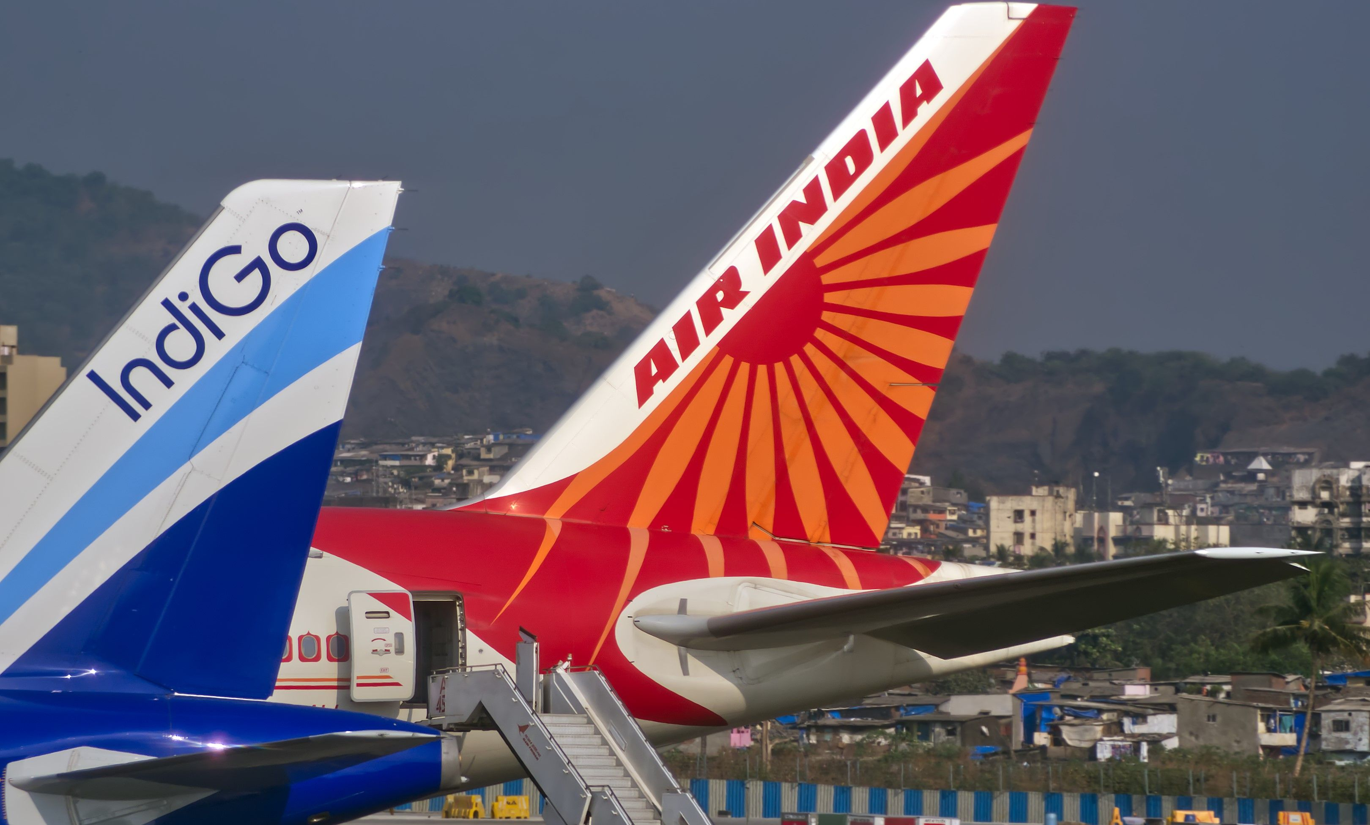
  Airline and Aircraft Orders
Indigo
Akasa Air
Air India Express
AIX Connect
Spice Jet
Indigo | 60.6%
Air India | 14.2%
Vistara | 9.2%
AIX Connect | 5.4%
Spice Jet | 4.7%
Go Air | -
Akasa | 4.4%
Others | 1.7%
Major Carriers
Air India
Visatra
Low Cost Carriers
Indigo (500), Akasa and Air India (470) have ordered over 1,120 airplanes. Akasa has ordered 150 B737 Max planes Indigo to induct A350-900 from 2027, with an option of 70 more. Air India has ordered 40 A350’s and 30 Boeing widebodies.

Slide 20
  Repossession - Recent Developments
May, 2023, Go First voluntarily seeks bankruptcy protection. Files for insolvency proceedings at National Company Law Tribunal (NCLT). Pratt & Whitney (P&W) Engines issues causes grounding of its aircraft, 27. The fleet size being 54. The MCA & GOI, issue a notification that the provisions of Section 14(1) of the Insolvency and Bankruptcy Code, 2016 (IBC) relating to the moratorium will not apply to transactions, relating to aircraft, engines, airframes and helicopters. Lessors still to repossess the aircraft due to lack of local legislation. April, 2024, the Delhi High Court (DHC) reaffirmed that the IBC code will exclude the aircraft, engines, airframes and helicopters from the moratorium and orders DGCA to process the de-registration applications. Lessors concerned on the physical status of aircraft and loss of rentals for a year.

Slide 21
THANKYOU

